Slide 1
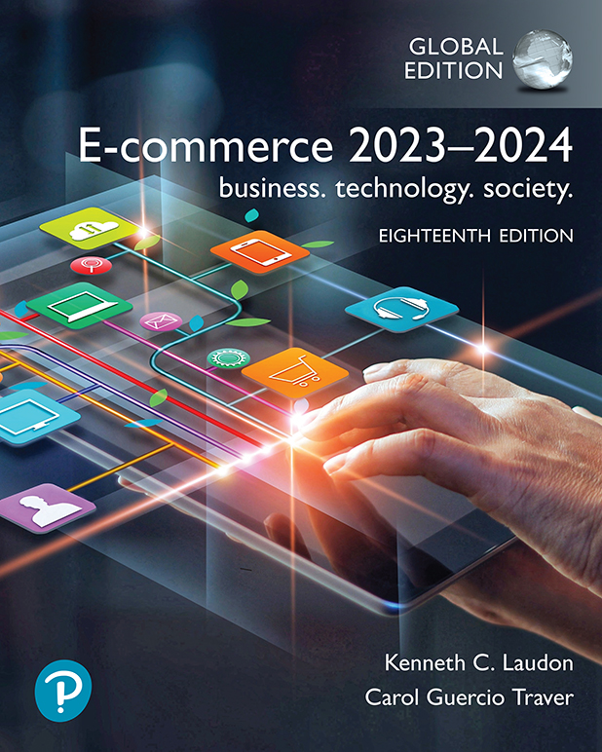
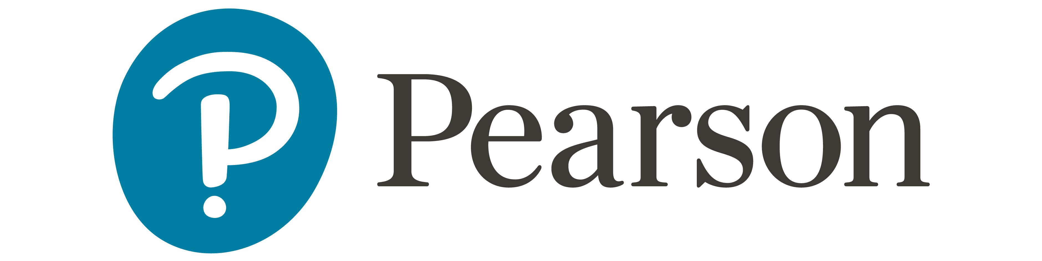
E-commerce 2023–2024: business. technology. society.
Eighteenth Edition
Chapter 6
E-commerce Marketing and Advertising
© 2023 Pearson Education Ltd. All Rights Reserved
Notes:
If this PowerPoint presentation contains mathematical equations, you may need to check that your computer has the following installed:
1) MathType Plugin
2) Math Player (free versions available)
3) NVDA Reader (free versions available)

Slide 2
Learning Objectives
6.1 Understand the key features of the Internet audience, the basic concepts of consumer behavior and purchasing, and how consumers behave online.
6.2 Identify and describe the basic digital commerce marketing and advertising strategies and tools.
6.3 Identify and describe the main technologies that support online marketing.
6.4 Understand the costs and benefits of online marketing communications.

Slide 3
In Mobi’s: Global Mobile Ad Network
Class Discussion
What advantages do mobiles have over traditional banner ads?
Where do social networking sites such as Facebook fit in to a marketing strategy featuring mobile ads?
What are some of the challenges and risks of placing ads on the Web?
Do you think Internet users will ever develop “blindness” toward ads on the Web as well?

Slide 4
Consumers Online: The Internet Audience and Consumer Behavior (1 of 3)
Around 300 million in the U.S. have Internet access in 2022
Growth rate has slowed
Intensity and scope of use both increasing
Some demographic groups have much higher percentages of online usage
Income, education, age, racial and ethnic dimensions

Slide 5
Consumers Online: The Internet Audience and Consumer Behavior (2 of 3)
Broadband and mobile
Inequalities in broadband access persist
Older adults, lower income, lower educational levels have lower broadband adoption levels
Non-broadband households still access Internet via mobile or other locations
Community effects
Neighborhood effects
Role of social emulation in consumption decisions
Relationship between being member of social networks and purchasing decisions
Increases research online/purchase offline(webrooming)
Notes:
Social emulation is the idea where whenever individuals buy cultural products conspicuously, they do it in order to emulate or 'imitate' their superiors or those in the higher-class sections of the social hierarchy.
Amazon’s recommender systems (Customer who bought this item also bought …) create co-purchase networks where people do not know one another personally, but nevertheless triple the influence of complementary products.

Slide 6
Consumers Online: The Internet Audience and Consumer Behavior (3 of 3)
Consumer behavior models
Study of consumer behavior; social science discipline
Attempt to predict or explain wide range of consumer decisions
Based on background demographic factors and other intervening, more immediate variables
Profiles of online consumers
Consumers shop online primarily for convenience

Slide 7
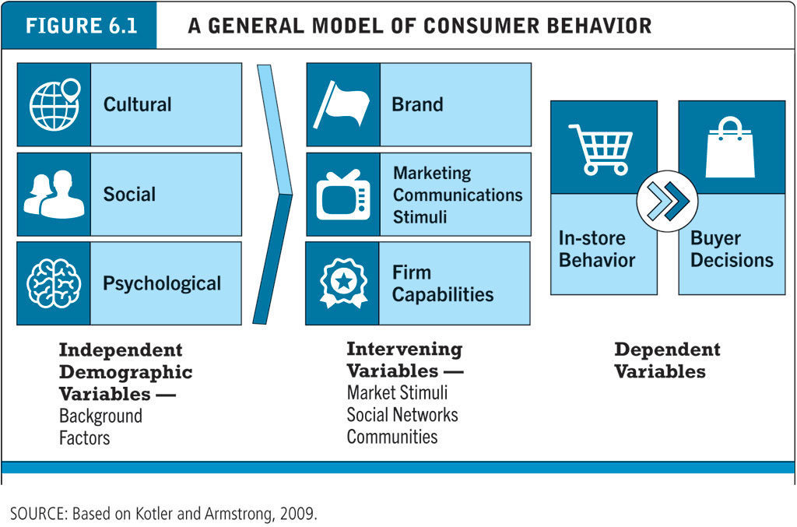
Figure 6.1 A General Model of Consumer Behavior
Notes:
Figure 6.1, Page 322.
Consumer behavior models try to predict the decisions that consumers make in the marketplace.
SOURCE: Based on Kotler and Armstrong, 2009.
Alt Text
Long description: The chart includes three sections from left to right labeled independent demographic variables or background factors, intervening variables or market stimuli social networks communities, and dependent variables. Independent demographic variables such as cultural, social, and psychological variables are background factors. Intervening variables include brand, marketing communications stimuli, and firm capabilities. Dependent variables include in-store behavior and buyer decisions.

Slide 8
The Online Purchasing Decision (1 of 2)
Five stages in consumer decision process
Awareness of need
Search for more information
Evaluation of alternatives
Actual purchase decision
Post-purchase contact with firm

Slide 9
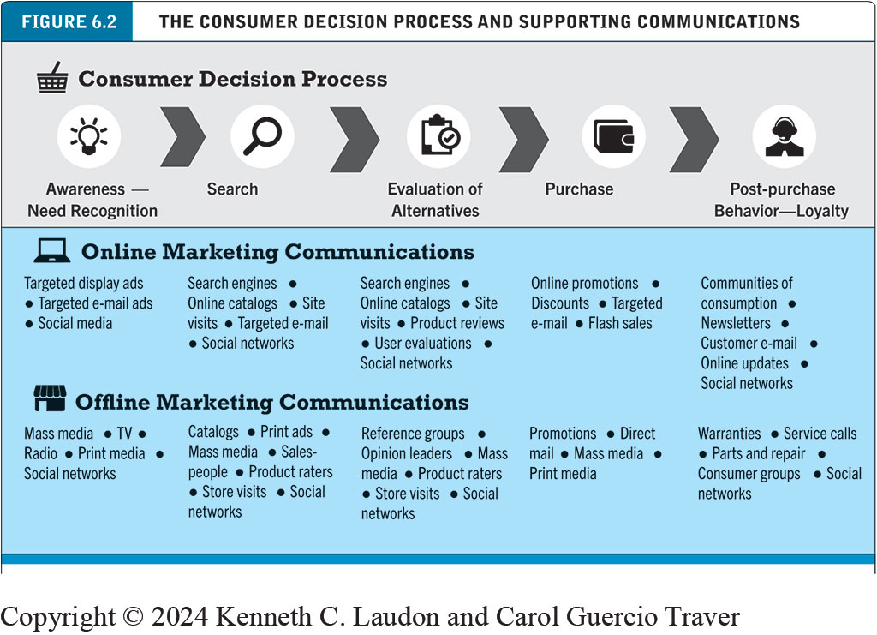
Figure 6.2 The Consumer Decision Process and Supporting Communications
Notes:
Figure 6.2, Page 323.
Alt Text
Long description: The consumer decision process from left to right is as follows. Awareness- needs recognition, search, evaluation of alternatives, purchase, and post-purchase behavior or loyalty. Online marketing communications tools supporting awareness and need recognition include targeted display ads, targeted e-mail ads, and social media. Offline marketing communications supporting awareness and need recognition include mass media, T V, radio, print media, and social networks. Online marketing communications supporting search include search engines, online catalogs, site visits, targeted e-mail, and social networks. Offline marketing communications supporting search include catalogs, print ads, mass media, salespeople, product raters, store visits, and social networks. Online marketing communications supporting the evaluation of alternatives include search engines, online catalogs, site visits, product reviews, user evaluations, and social networks. Offline marketing communications supporting the evaluation of alternatives include reference groups, opinion leaders, mass media, product raters, store visits, and social networks. Online marketing communications supporting purchases include online promotions, discounts, targeted e-mail, and flash sales. Offline marketing communications supporting purchases include promotions, direct mail, mass media, and print mail. Online marketing communications supporting post-purchase behavior include communities of consumption, newsletters, customer e mail, online updates, and social networks. Offline communications for supporting post purchase behavior include warranties, service calls, parts and repair, consumer groups, social networks.

Slide 10
The Online Purchasing Decision (2 of 2)
Decision process similar for online and offline behavior
General online behavior model
User characteristics
Product characteristics
Website features: latency, usability, security
Attitudes toward online purchasing
Perceptions about control over Web environment
Clickstream behavior

Slide 11
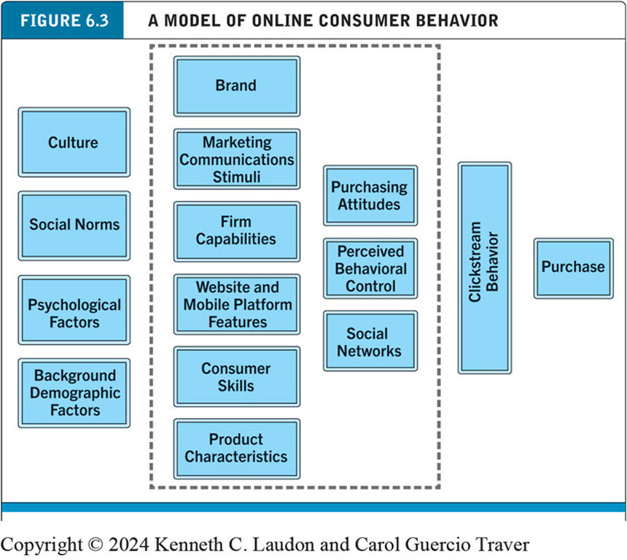
Figure 6.3 A Model of Online Consumer Behavior
Notes:
Figure 6.3, Page 324.
In this general model of online consumer behavior, the decision to purchase is shaped by background demographic factors, several intervening factors, and, finally, influenced greatly by clickstream behavior very near to the precise moment of purchase.
Alt Text
Long description: Background factors include culture, social norms, psychological factors, and background demographic factors. Intervening factors include brand, marketing communications stimuli, firm capabilities, website, and mobile platform features, consumer skills, product characteristics, purchasing attitudes, perceived behavioral control, and social networks. The final influence is clickstream behavior and purchase.

Slide 12
Shoppers: Browsers and Buyers
Shoppers: More than 92.5% of Internet users
83.5% are buyers
About 9% are browsers (purchase offline)
Only 7.4% don’t shop online
Online research influences nearly two-thirds of all U.S. retail sales
Online traffic also influenced by offline brands and shopping
E-commerce and traditional commerce are coupled: Part of a continuum of consuming behavior

Slide 13
How Shoppers Find Vendors Online
Shoppers are highly intentional and goal-oriented
Typically, focused browsers
Use search engines
Many go directly to online marketplace (Amazon, eBay)
Some go directly to specific retail websites

Slide 14
Trust, Utility, and Opportunism in Online Markets
Two most important factors shaping decision to purchase online
Utility
Better prices, convenience, speed
Trust
Perception of credibility, ease of use, perceived risk
Sellers develop trust by building strong reputations for honesty, fairness, delivery

Slide 15
Digital Commerce Marketing and Advertising: Strategies and Tools
Features of Internet marketing (versus traditional)
More personalized
More participatory
More peer-to-peer
More communal
The most effective Internet marketing has all four features

Slide 16
Main Elements of a Comprehensive Multi-Channel Marketing Plan
Website
Traditional online marketing
Search engine, display, e-mail, affiliate
Social marketing
Social networks, blogs, visual, video, game, metaverse and NFT
Mobile marketing
Mobile/tablet sites, apps
Offline marketing
Television, newspapers, magazines, radio

Slide 17
Strategic Issues and Questions
Which part of the marketing plan should you focus on first?
How do you integrate the different platforms for a coherent message?
How do you allocate resources?
How do you measure and compare metrics from different platforms?
How do you link each to sales revenues?

Slide 18
The Website as a Marketing Platform: Establishing the Customer Relationship
Website functions to:
Establish brand identity and customer expectations
Differentiating product
Anchor the brand online
Central point for all marketing messages
Inform and educate customer
Shape customer experience

Slide 19
Online Marketing and Advertising
Online advertising
Display, search, mobile messaging, sponsorships, classifieds, lead generation, e-mail
Advantages
Best way to reach the 18-to-34-year-old audience
Ad targeting to individuals
Price discrimination
Personalization

Slide 20
Traditional Online Marketing and Advertising Tools
Search engine marketing and advertising
Display ad marketing (including video ads)
E-mail marketing
Affiliate marketing
Lead generation marketing
Notes:
Search engine marketing: involves the use of search engines to build and sustain brands
Search engine advertising: involves the use of search engines to support direct sales online.
Organic search: inclusion and ranking of sites depends on a more or less unbiased application of a set of rules imposed by the search engine
Affiliate marketing is the process by which an affiliate earns a commission for marketing another person's or company's products. The affiliate simply searches for a product they enjoy, then promotes that product and earns a piece of the profit from each sale they make.
Viral marketing is a style of promotion that relies on an audience to generate the message of a product or service. Marketing is considered “viral” when it reaches the point where it's being shared by the public at large rather than just its target audience.
Lead generation, the marketing process of stimulating and capturing interest in a product or service for the purpose of developing a sales pipeline, allows companies to nurture targets until they're ready to buy.

Slide 21
Search Engine Marketing and Advertising (1 of 2)
Search engine marketing (S E M)
Use of search engines for branding
Search engine advertising
Use of search engines to support direct sales
Pay-per-click (PPC) search ads
Keyword advertising: Google Ads
Google AdSense: Publishers (websites) allow Google to place relevant ads on their sites
$209 billion in 2021(Statista, 2022)
Search engine optimization
Important because Google makes frequent changes to its algorithms
Notes:
Keyword advertising: Merchants purchase keywords through a bidding process at search sites, and whenever a consumer searches for that word, their advertisement shows up somewhere on the page.
Network keyword advertising: introduced by Google as its AdSense product in 2002. Publishers join these networks and allow the search engine to place “relevant” ads on their sites
Google's advertising revenue in 2021 reached $209 billion, and a majority of it came from search advertising – a form of online advertising.
Statista Research Department. Google: advertising revenue from 2001 to 2021. 2022. https://www.statista.com/statistics/266249/advertising-revenue-of-google/.

Slide 22
Search Engine Marketing and Advertising (2 of 2)
Visual search
Machine learning and computer vision
Examples: Google Lens; Pinterest Lens
Voice search
Natural language processing
Search engine issues
Ranking practices
Click fraud
Content farms and link farms
Notes:
SEO – techniques to improve the ranking of web pages generated by search engine algorithms.
A link farm is a group of websites that all link to the other websites in the group to increase rankings in the search results (SERPs). This technique is a black-hat technique, which means that it is considered a manipulative technique. It is also considered a form of spam and sites which search engines like Google determine to be involved in link farms are penalised for it.
A content farm is a website that produces a large amount of low-quality articles on many different topics, then uses keywords so that they are placed highly on Google or other search engine results.
Click fraud is the act of clicking on a paid link, such as display ad or sponsored search result, with malicious or vindictive intent.

Slide 23
Display Ad Marketing (1 of 3)
Banner ads
Rich media ads
Interstitial ads
Video ads
Far more effective than other display formats
Sponsorships
Native advertising
Content marketing
Notes:
Interstitial ads are full-screen ads that cover the interface of their host app. They're typically displayed at natural transition points in the flow of an app, such as between activities or during the pause between levels in a game.
Native advertising is the use of paid ads that fit seamlessly into the media where they appear. They blend in to match the content so that they don’t disrupt the viewer’s experience. In this way, advertisers can post content that hooks viewers’ attention by not being an obvious ad.
Content marketing is a marketing strategy used to attract, engage, and retain an audience by creating and sharing relevant articles, videos, podcasts, and other media. This approach establishes expertise, promotes brand awareness, and keeps your business top of mind when it's time to buy what you sell.

Slide 24
Display Ad Marketing (2 of 3)
Advertising networks
Specialized marketing firms involved in process of buying and selling online ads
Ad exchanges
Digital marketplace that uses automated auction method known as programmatic advertising
Real-time bidding (R T B)
Process used to match advertising demand with publisher supply

Slide 25
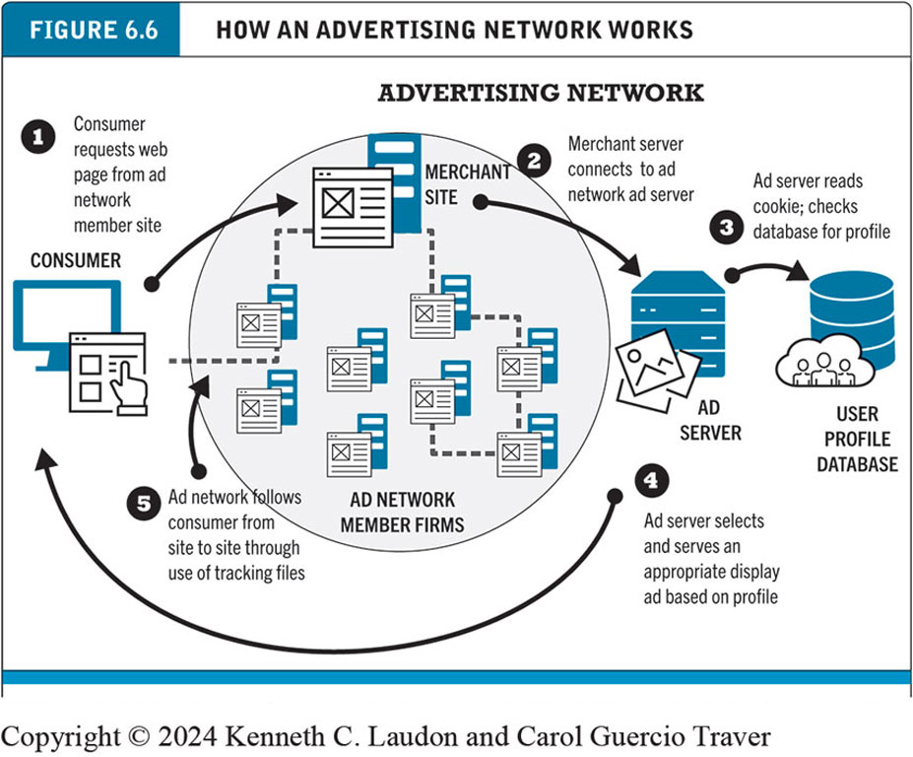
Figure 6.6 How an Advertising Network Works
Notes:
Figure 6.6, Page 338.
Millions of publishers have audiences to sell, and pages to fill with ads. Thousands of advertisers are looking for audiences. Ad networks are intermediaries that connect publishers with marketers.
Alt Text
Long description: The five steps involved in an advertising network are as follows. Step 1, consumer requests web page from ad network member site. 2, merchant server connects to ad network ad server. 3, ad server reads cookie, checks database for profile. 4, ad server selects and serves an appropriate display ad based in profile. 5, ad network follows consumer from site to site through use of tracking files.

Slide 26
Display Ad Marketing (3 of 3)
Display advertising issues
Ad fraud
Sources: Botnets, browser extensions, ad targeting firms; hired individuals
Viewability
Significant portion of online ads are not actually viewed or viewable
Ad blocking software
Use is growing
Notes:
Ad fraud is a type of scam in which the perpetrator fools advertisers into paying for something that is worthless to them, such as fake traffic, fake leads or misrepresented and ineffective ad placement.

Slide 27
E-mail Marketing
Direct e-mail marketing
Messages sent directly to interested users
Benefits include
Inexpensive
Average around 3% to 4% click-throughs
Ability to measure and track responses
Personalization and targeting
Three main challenges
Spam
Anti-spam software
Poorly targeted purchased e-mail lists

Slide 28
Spam
Unsolicited commercial e-mail
Around 45% of all e-mail in 2022
Most originates from bot networks
Legislative efforts to control spam (CAN-SPAM Act) have largely failed
Notes:
Controlling the Assault of Non-Solicited Pornography and Marketing Act (CAN-SPAM Act)
Digital Markets Act (DMA) - European Union

Slide 29
Other Types of Traditional Online Marketing
Affiliate marketing
Commission fee paid to other websites for sending customers to their website
Lead generation marketing
Services and tools for collecting, managing, and converting leads

Slide 30
Social, Mobile, and Local Marketing and Advertising
Social marketing and advertising
Use of online social networks and communities; blogs; influencer marketing
Mobile marketing and advertising
Search, display ads, games, e-mail, text messaging, in-store messaging, Quick Response codes; couponing
Local marketing
Local search; local advertising on social networks; daily deal sites
Examined in greater depth in Chapter 7

Slide 31
Multi-Channel Marketing
Integration of online and offline marketing
Increasing percentage of American media consumers use several media at once
Reinforce branding messages across media
Most effective multi-channel campaigns use consistent imagery across media

Slide 32
Insight on Business: Are the Very Rich Different From You and Me?
Class Discussion
What distinguishes luxury marketing from ordinary retail marketing?
What challenges do luxury retailers have in translating their brands and the look and feel of luxury shops into websites?
How has social media affected luxury marketing?
Visit the Net-a-Porter website. What do you find there?

Slide 33
Other Online Marketing Strategies
Customer retention strategies
One-to-one marketing (personalization)
Behavioral targeting (interest-based advertising)
Retargeting
Customization and customer co-production
Customer service
F A Q s
Real-time customer service chat systems
Automated response systems

Slide 34
Pricing Strategies (1 of 2)
Pricing: integral part of marketing strategy
Traditional pricing based on fixed costs, variable costs, demand curve
Marginal costs
Marginal revenue
Piggyback strategy
Price discrimination
Notes:
Piggyback strategy: A low cost market entry strategy in which two or more firms represent one another’s complementary (but non-competing) products in their respective markets.
Price discrimination is a selling strategy that charges customers different prices for the same product or service based on what the seller thinks they can get the customer to agree to.

Slide 35
Pricing Strategies (2 of 2)
Free and freemium
Versioning
Bundling
Dynamic pricing
Auctions
Yield management
Surge pricing
Flash marketing
Notes:
Versioning: Airline companies usually provide two or three levels of seats, such as economy class seats, business class seats, and first-class seats.
Yield management is a dynamic hotel pricing strategy designed to produce the maximum revenue, or yield, from a set inventory of rooms. It’s about understanding and influencing traveler booking behavior and finding the optimal balance between occupancy and rate. Yield management is often described as “selling the right room to the right customer (guest) at the right time for the right price.”
A company that openly applies surge-pricing tactics and informs its customers about it, is Uber. Whenever there is high demand for taxis, often caused at rush hours or other peak periods such as special events or bad weather and not many drivers are on the road, consumers will see an increase in price

Slide 36
Long Tail Marketing
Internet and e-commerce enables sales of obscure products with little demand
Substantial revenue because:
Near zero inventory costs
Little marketing costs
Search and recommendation engines
Notes:
The long tail is a business strategy that allows companies to realize significant profits by selling low volumes of hard-to-find items to many customers, instead of only selling large volumes of a reduced number of popular items.

Slide 37
Insight on Technology: The Long Tail: Big Hits and Big Misses
Class Discussion
What are recommender systems? Give an example of one you have used.
What is the Long Tail and how do recommender systems support sales of items in the Long Tail?
How can human editors, including consumers, make recommender systems more helpful?

Slide 38
Online Marketing Technologies
Internet’s main impacts on marketing
Scope of marketing communications broadened
Richness of marketing communications increased
Information intensity of marketplace expanded
Always-on mobile environment expands marketing opportunities

Slide 39
Web Transaction Logs
Built into web server software
Records user activity at website
Provides much marketing data, especially combined with:
Registration forms
Shopping cart database
Answers questions such as:
What are major patterns of interest and purchase?
After home page, where do users go first? Second?

Slide 40
Cookies and Tracking Files
First-party versus third-party tracking
Types of tracking files
Cookies
First-party uses data only from website user is visiting
Third-party tracks users across websites
Web beacons (“bugs”)
Third-party tracking being phased out due public and political resistance
Example: Apple’s Intelligent Tracking Prevention program for Safari browser
Notes:
Third-party cookies are generated and placed on the user's device by a different website other than the one the user is visiting. They are created when a user visits a website that includes elements from other sites, such as third-party images or ads.
A web beacon is a technique used on web pages and email to unobtrusively allow checking that a user has accessed some content. Web beacons are typically used by third parties to monitor the activity of users at a website for the purpose of web analytics or page tagging. They can also be used for email tracking.

Slide 41
Insight on Society: Going From Third to First
Class Discussion
Do you mind being tracked by third-party cookies?
Why has Google been so slow to eliminate third-party tracking compared to Apple?
What do you think of Google’s current Privacy Sandbox alternatives: FLEDGE and Topics?
What is a data clean room and how does it help preserve user privacy?

Slide 42
Databases
Store data in form of fields, records and files
Relational database: represents data as two-dimensional table
Database management system (D B M S)
S Q L (Structured Query Language)
Industry-standard database query and manipulation language used in a relational database
Nonrelational (NoSQL) databases
More flexible data model; designed for managing large sets of structured and unstructured data

Slide 43
Data Warehouses and Data Mining
Data warehouse: Collects firm’s transactional and customer data in single location for offline analysis by marketers and site managers
Data mart: Subset of data warehouse in which a summarized or highly focused portion of organization’s data is placed
Data lake: Repository of raw unstructured or structured data that has not yet been analyzed
Data mining: Analytical techniques to find patterns in data, model behavior of customers, develop customer profiles

Slide 44
The Challenge of Big Data
Big data
Petabyte, exabyte range
Web traffic, e-mail, social media, content
Traditional D B M S unable to process the increasing volume of data
Hadoop
Open-source software framework
Processes any type of data, even unstructured
Distributed processing
Apache Spark
Hadoop alternative

Slide 45
Marketing Automation and Customer Relationship Management (C R M) Systems
Marketing automation systems
Track steps in lead generation
C R M systems
Manage relationship with customers once purchase is made
Create customer profiles
Customer data used to:
Develop and sell additional products
Identify profitable customers
Optimize service delivery, and so on

Slide 46
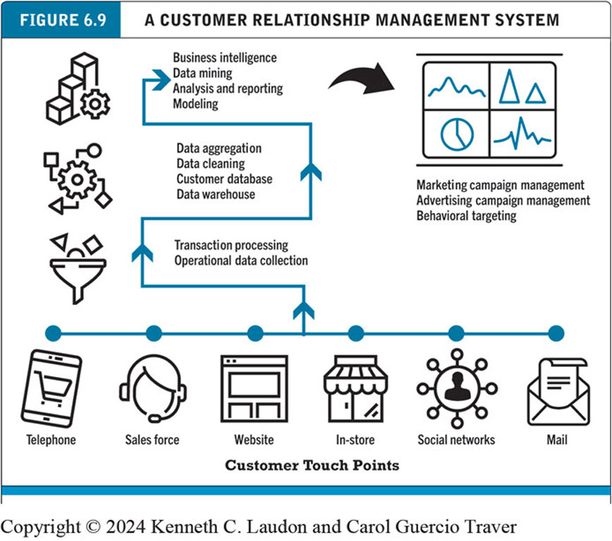
Figure 6.9 A Customer Relationship Management System
Notes:
Figure 6.9, Page 366.
This is an example of a CRM system. The system captures customer information from all customer touchpoints as well as other data sources, merges the data, and aggregates it into a single customer data repository or data warehouse where it can be used to provide better service, as well as to construct customer profiles for marketing purposes. Online analytical processing (OLAP) allows managers to dynamically analyze customer activities to spot trends or problems involving customers. Other analytical software programs analyze aggregate customer behavior to identify profitable and unprofitable customers as well as customer activities.
Alt Text
Long description: Customer touch points include telephone, sales force, website, in store, social networks, and mail. The touch points lead to transaction processing and operational data collection, followed by data aggregation, data cleaning, and customer database and data warehouse, leading to business intelligence, data mining, analysis and reporting and modelling, which contributes to marketing campaign management, advertising campaign management, and behavioral targeting.

Slide 47
Online Marketing Metrics: Lexicon
Audience size/market share metrics
Impressions, click-through rate (C T R), page views, viewability rate, stickiness, loyalty, reach, recency
Conversion to customer metrics
Acquisition rate, conversion rate, browse-to-buy ratio, cart conversion rate, abandonment rate
Video ad metrics
View time, completion rate
E-mail campaign metrics
Open rate, delivery rate, click-through rate, bounce-back rate
Notes:
Viewability Rate is the percentage of ads that are actually seen by a user.
By this we mean, the viewability rate is the percentage of ad impressions that count as being viewed. A viewed impression is described as being at least 50% on screen for one second. For example, if a website has 10 ad impressions, of which five are counted as viewable, then the site will have a Viewability Rate of 50%.
Customer stickiness is a marketing term describing the tendency to gain repeat business. Stickiness determines the likeliness of a customer “sticking” to your brand by making a purchase more than once.
Reach in marketing is the measurement of the size of the audience that has seen your ads or campaign content. Reach measures your actual audience, and marketing reach measures the potential customers a campaign could reach. These can refer to specific audience segments or to a broader percentage of the population.
Recency: Recency refers to how recent a customer's last purchase was. Customers who have made a recent purchase, typically within the last few weeks, still have the product and brand on their minds and are most likely to make a repeat purchase.

Slide 48
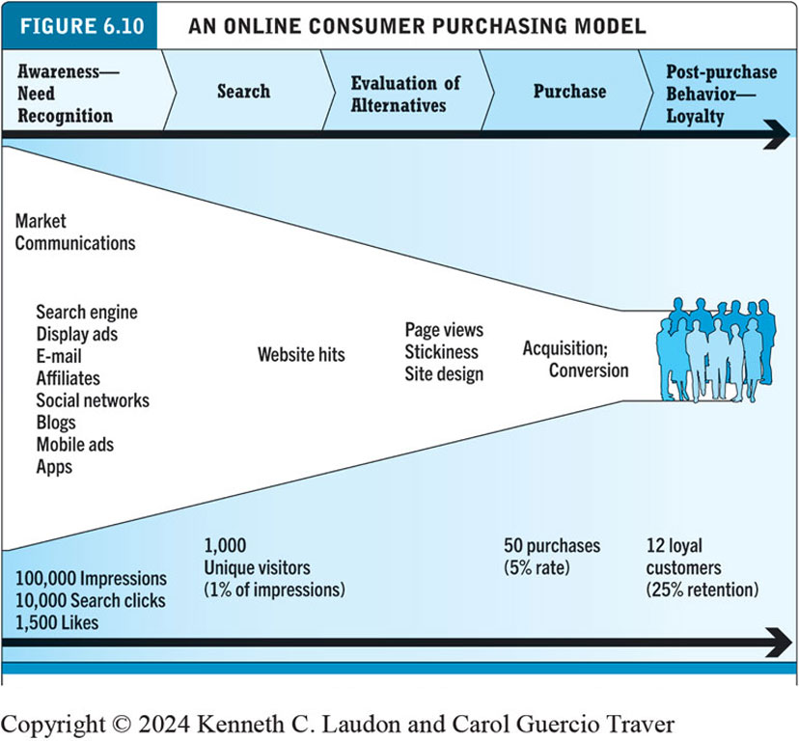
Figure 6.10 An Online Consumer Purchasing Model
Notes:
Figure 6.10, Page 370.
The conversion of visitors into customers, and then loyal customers, is a complex and long-term process that may take several months.
Alt Text
Long description: The process on top from left to right is as follows. Awareness and need recognition; search; evaluation of alternatives; purchase, and post-purchase behavior loyalty. The funnel stages corresponding to the steps are as follows. Awareness needs recognition: market communications like search engines, display ads, e-mail, affiliates, social networks, blogs, mobile ads, and apps; 100,000 impressions, 10,000 search clicks, and 1,500 likes. Search: website hits; 1,000 unique visitors, 1 percent of the impressions. Evaluation of alternatives: page views, stickiness, and site design. Purchase phase: acquisition, conversion, 50 purchases, a 5 percent rate. Post-purchase behavior and loyalty phase: 12 loyal customers and 25 percent retention.

Slide 49
How Well Does Online Advertising Work?
Use R O I to measure ad campaign
Difficulty of cross-platform attribution
Google update to ad attribution model
Highest click-through rates: Search engine ads, permission e-mail campaigns
Online channels compare favorably with traditional
Most powerful marketing campaigns use multiple channels, including online, catalog, T V, radio, newspapers, stores

Slide 50
The Costs of Online Advertising
Pricing models
Barter, cost per thousand (C P M), cost per click (C P C), cost per action (C P A), hybrid, sponsorship
Measuring issues
Correlating online marketing to online or offline sales
In general, online marketing is more expensive on C P M basis, but more efficient in producing sales
Effective cost-per-thousand (e C P M)

Slide 51
Marketing Analytics
Software that analyzes data at each stage of the customer conversion process
Awareness
Engagement
Interaction
Purchase activity
Loyalty and post-purchase
Helps managers
Optimize R O I on website and marketing efforts
Build detailed customer profiles
Measure impact of marketing campaigns

Slide 52
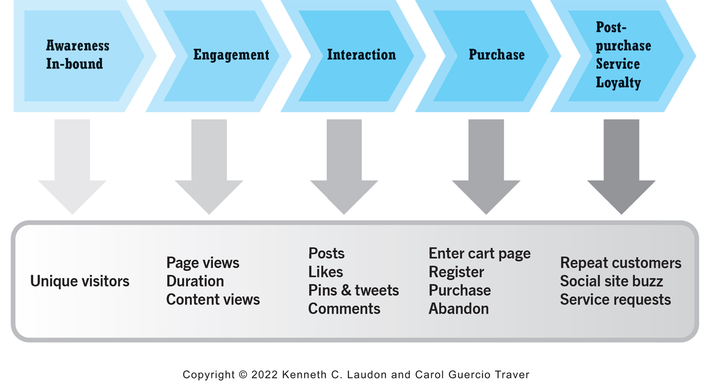
Figure 6.11 Marketing Analytics and the Online Purchasing Process
Notes:
Figure 6.11, Page 374.
Marketing analytics help e-commerce firms to better understand consumer behavior at each stage of the online purchasing process.
Alt Text
Long description: The steps in the online purchasing process and the corresponding analytics from left to right are as follows. Awareness in-bound: unique visitors. Engagement: page views, duration, and content views. Interaction: posts, likes, pins and tweets, and comments. Purchase: enter cart page, register, purchase, and abandon. Post-purchase service or loyalty: repeat customers, social site buzz, and service requests.

Slide 53
Careers in E-commerce
Position: Digital Marketing Assistant
Qualification/Skills
Preparing for the Interview
Possible Interview Questions

Slide 54

Copyright
This work is protected by United Kingdom copyright laws and is provided solely for the use of instructors in teaching their courses and assessing student learning. Dissemination or sale of any part of this work (including on the World Wide Web) will destroy the integrity of the work and is not permitted. The work and materials from it should never be made available to students except by instructors using the accompanying text in their classes. All recipients of this work are expected to abide by these restrictions and to honor the intended pedagogical purposes and the needs of other instructors who rely on these materials.

